Slide 2
Regeneration and Fuel Loading with Varying Overstory Retention in Redwood Stands 10 Years after Transformation to Multiaged Management
Thesis committee presentation by Judson Fisher

Slide 3
Thank you
Notes:
Thank you for being here
exciting time
appreciate your willingness to see me through to the finish
by the end
good understanding of project
some idea of where you’ll be able to offer support/feedback

Slide 4
Today’s plan
Introduction
What we did
Some results
My questions
Your questions

Slide 5
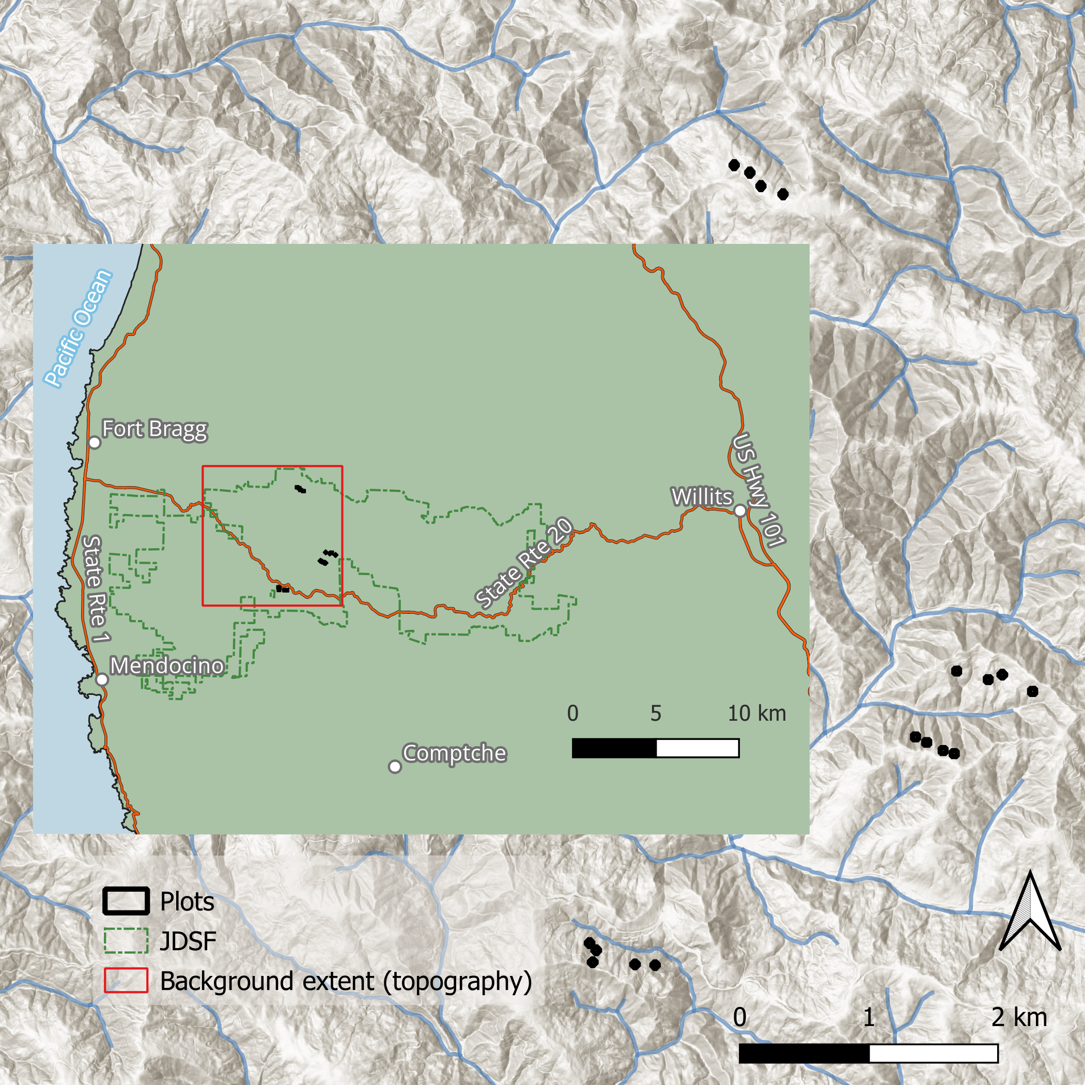
A multiaged silviculture experiment
Notes:
10 years ago, Pascal implemented a large scale, replicated, manipulative silvicultural experiment to demonstrate and study the transformation from even-aged to multiaged management in redwood dominated forests in the Jackson Demonstration State Forest in Mendocino County. My thesis serves as a 10-year report of the remeasurement of several key factors of that experiment —- sprout heights, regeneration density, and fuels.

Slide 6
An important part of ecological forest management
Diversity of forest structures == Diversity of silvicultural techniques
Predominance of even-aged management
This work contributes to our understanding of multiaged stand development
Greater understanding -> increased adoption
Notes:
Why study multiaged management?

Slide 7
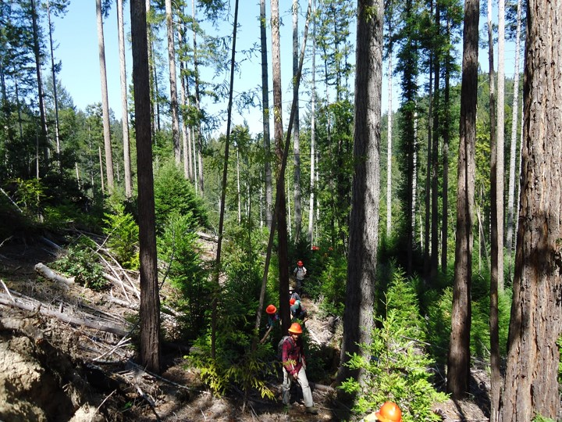
Suitability of redwood forests
Timber value
Shade tolerance
Reliable regeneration
Notes:
Why do this study in redwood forests?

Slide 8
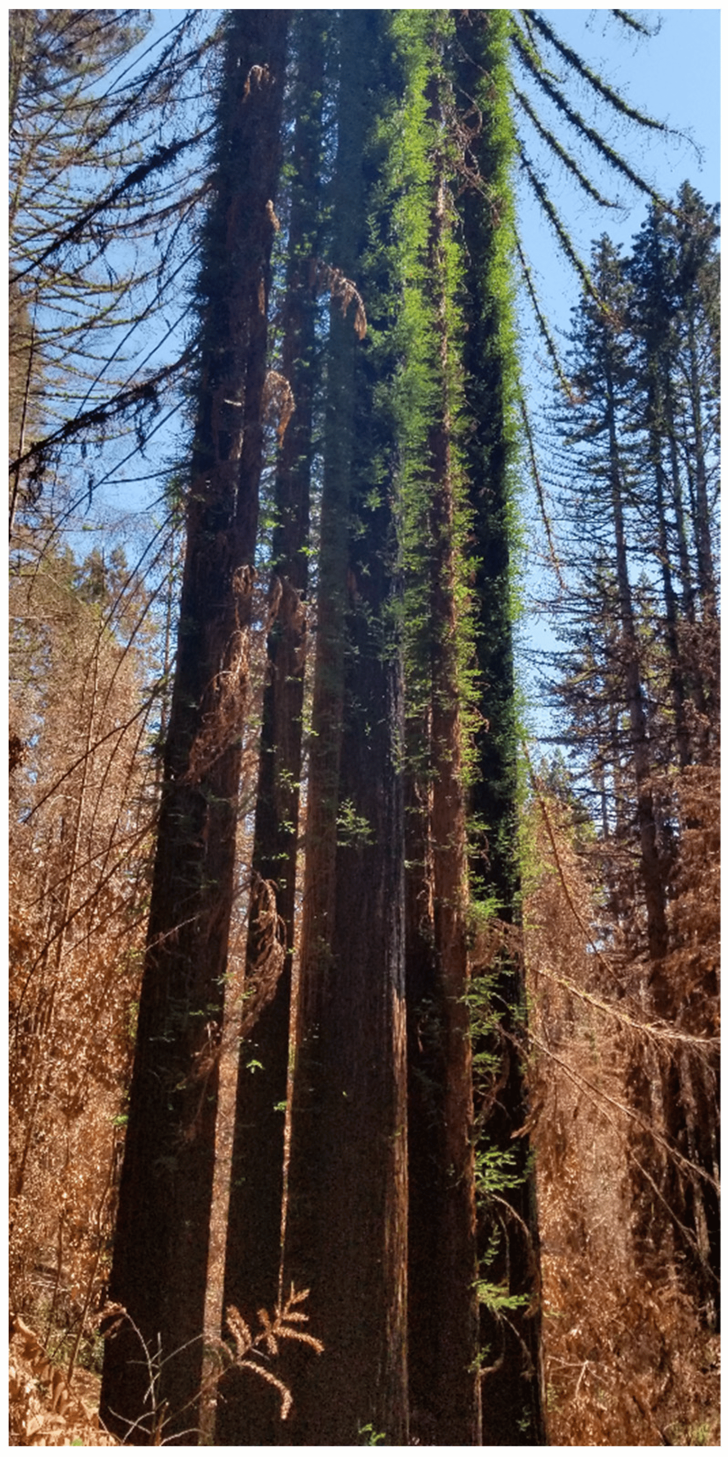
Fire-informed management
Slow adoption of fire-informed management on the North Coast
Redwood is a fire-adapted species
Historical record shows frequent fire
What is the pyrosilvicultural significance of our management actions?
Notes:
Why study fuels in addition to tree growth?

Slide 9
Today’s plan
Introduction
What we did
Some results
My questions
Your questions
Notes:
Now that you have and idea of the what and why, I’ll explain more of the details of what we did.

Slide 10
What we did
Implementation
Sampling procedure
Analysis
Notes:
I’ve broken this section into 3 parts.
By the end of this section you’ll understand how the treatments and how they were applied across the landscape.

Slide 11
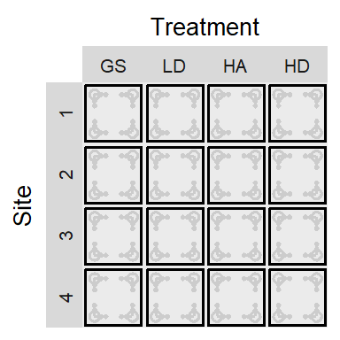
Initial harvest: 2012
16 one-hectare blocks
GS: Group selection
LD: Low density dispersed
HA: High density aggregated
HD: High density dispersed
These four treatments were replicated across four sites.
Notes:
This is how the treatments are defined. They are listed in order from least, to greatest amount of competition (light and growing space).

Slide 12
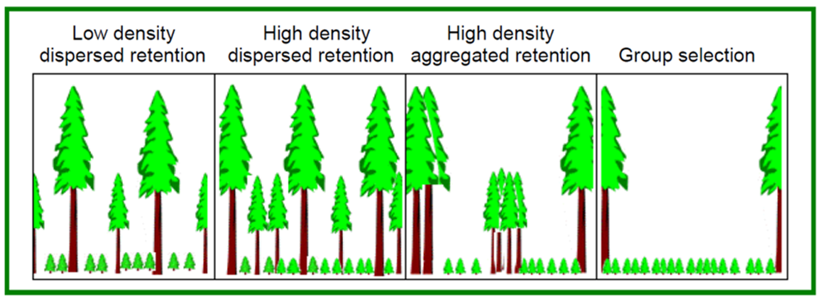
The treatments are defined in terms of retained trees after harvest
Notes:
And this is that the treatments mean, in a schematic representation.

Slide 13
One site

Slide 14
GS

Slide 15
LD

Slide 16
HA

Slide 17
HD

Slide 18
What we did
Implementation
Sampling procedure
Analysis
Notes:
At the end of this next section, you’ll understand how my sampling design resulted in response variables across three categories:
Sprout heights
Regeneration density
Fuels

Slide 19
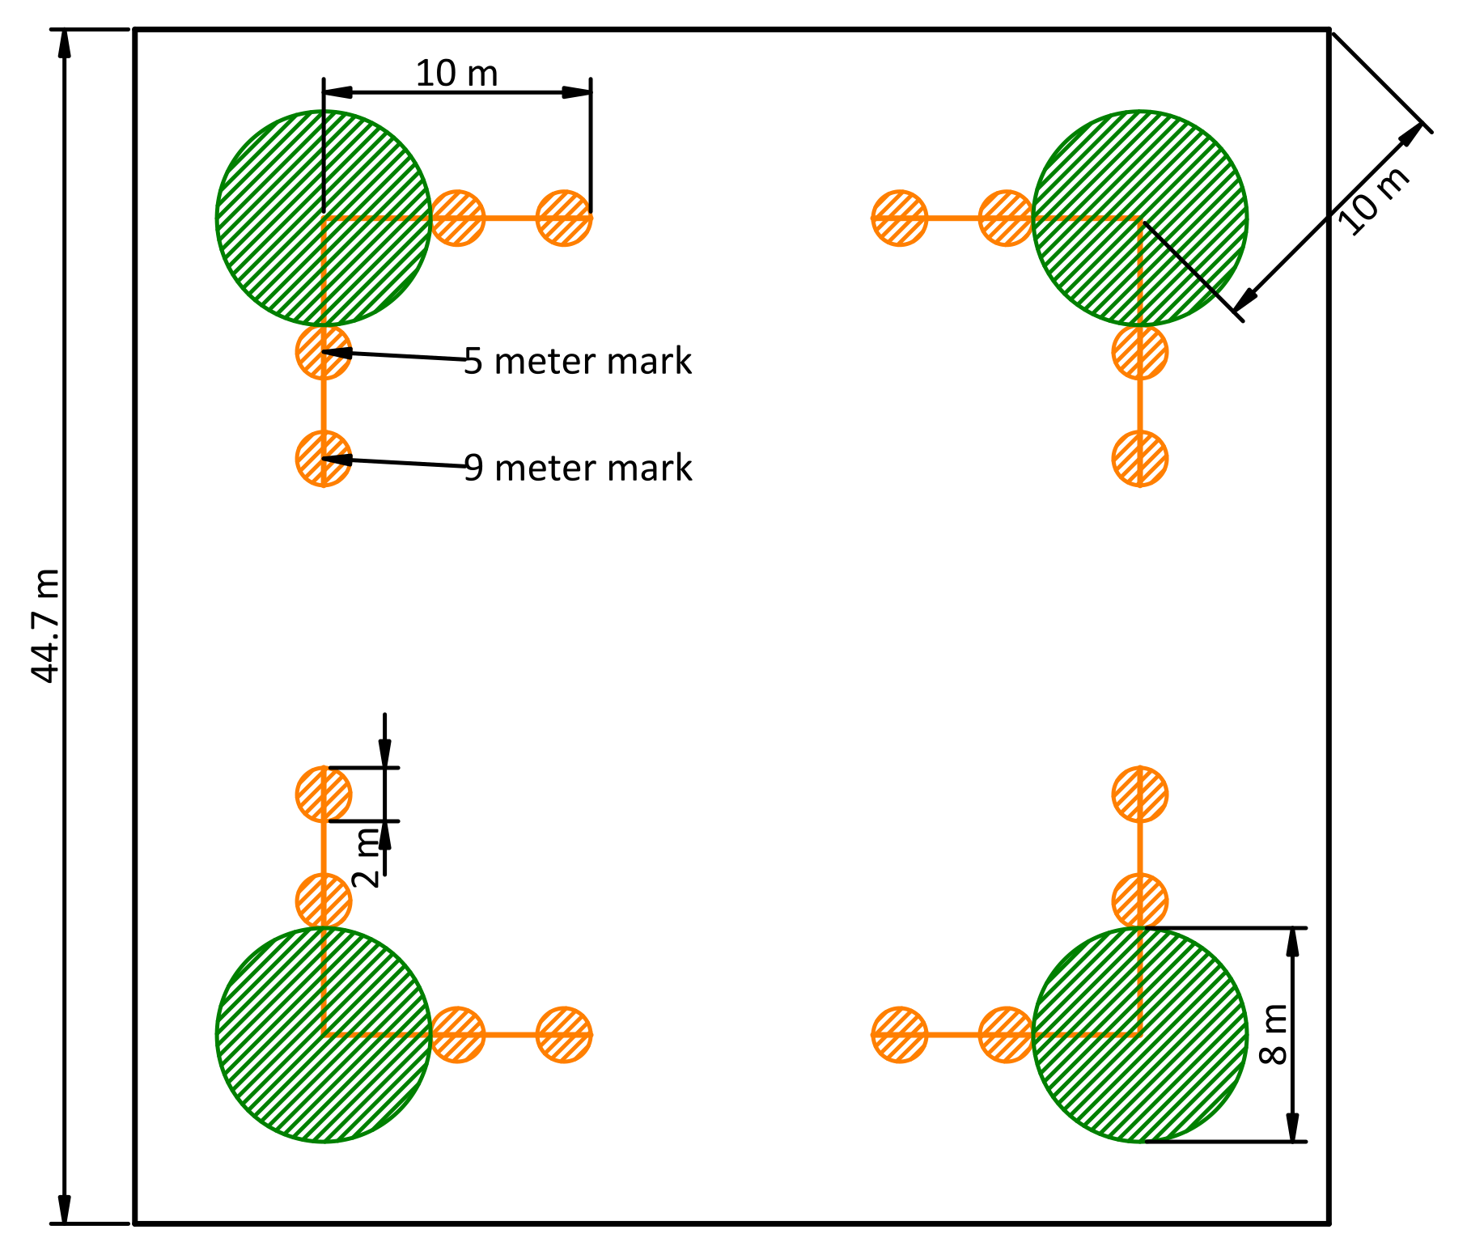
The plot structure
Macro plot (Outline)
Regeneration plots (green circles)
Fuel transects (orange lines)
Fuel sampling cylinders (orange circles)
Notes:
Here I define the various aspects of the sampling design.
Next, I’ll describe what we sampled in each of these.

Slide 20
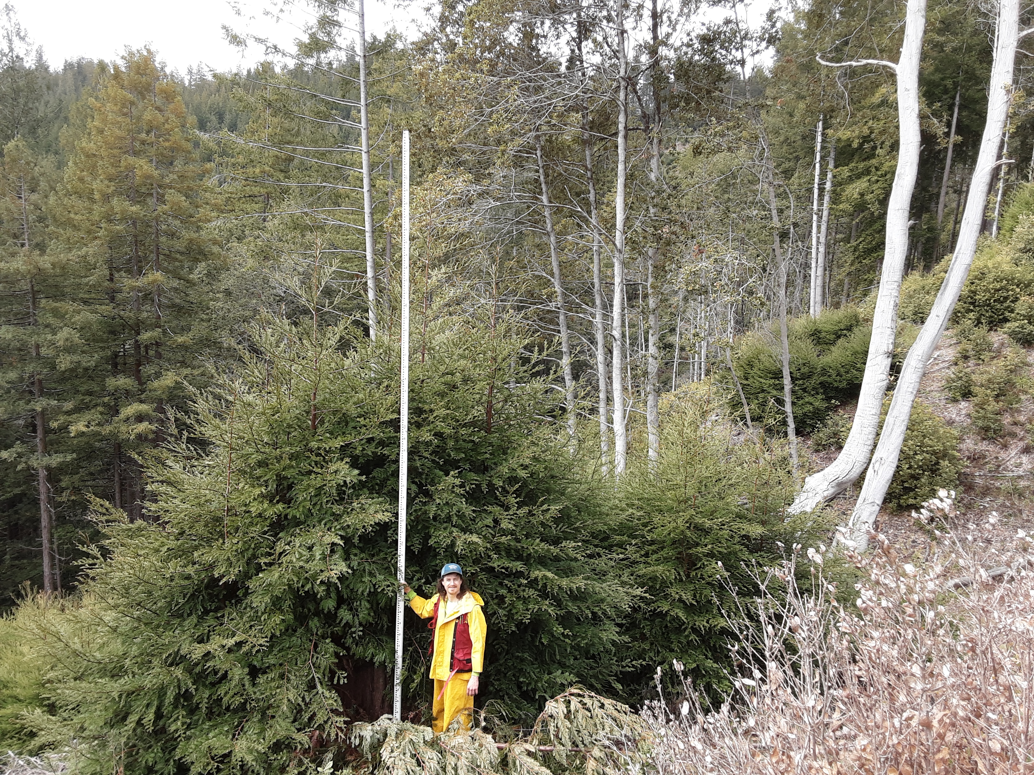
Sprout height
25 each of tanoak and redwood sprout clumps were selected for measurement
Tallest sprout in clump measured at years 1, 5, and 10

Slide 21
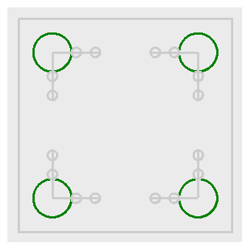
Regeneration density and composition
We recorded diameter and species of all sprouts and seedlings taller than 1.4 m

Slide 22
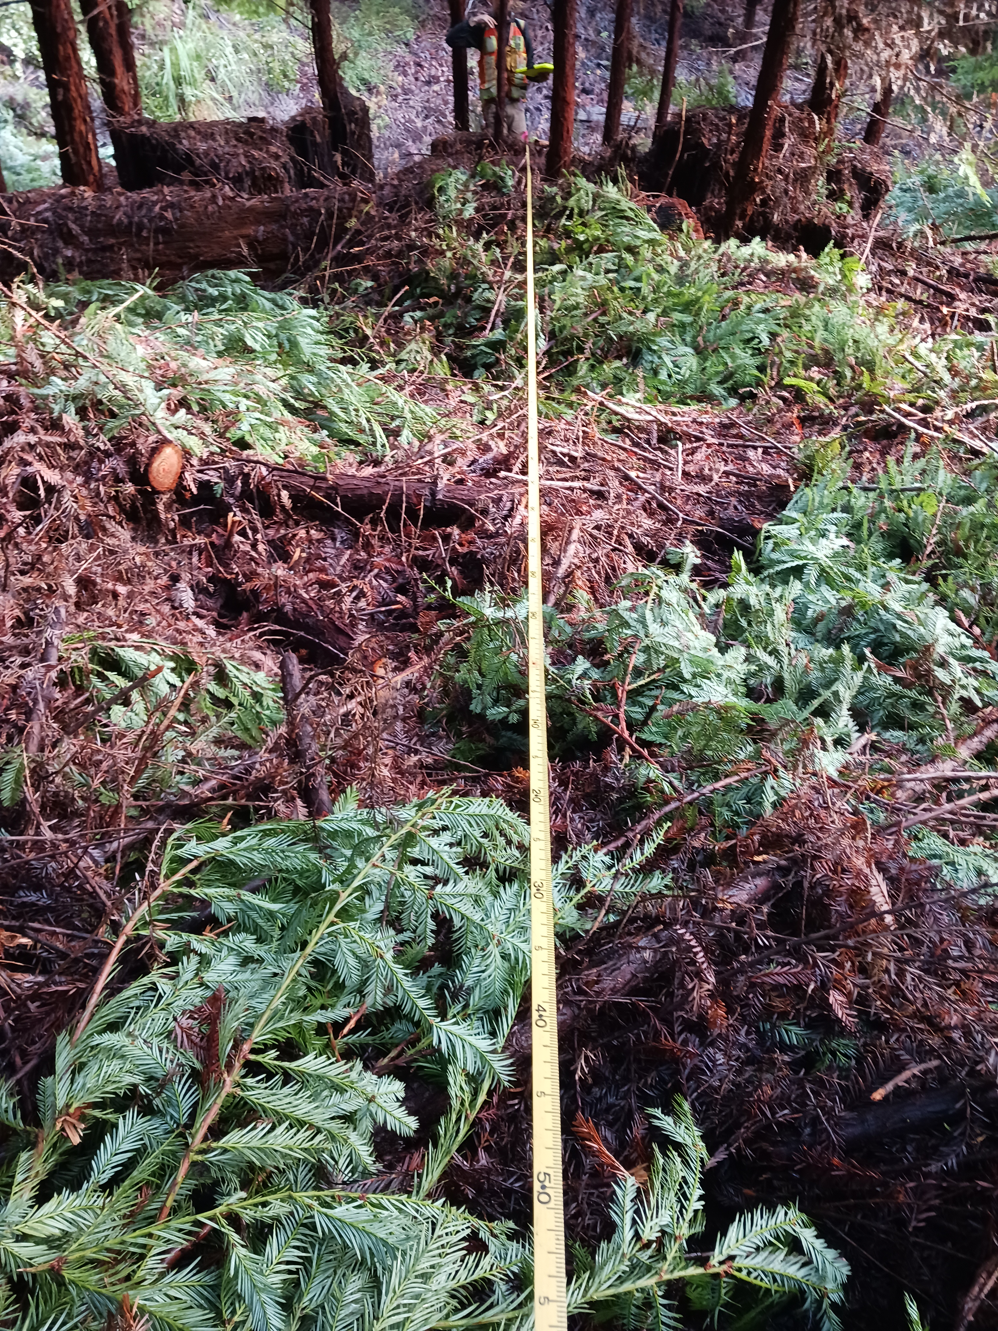
Downed woody fuel
Particles were tallied by size class
Counts were converted to load (Mg/ha) using linear intersect theory and parameters from the literature
A transect

Slide 23
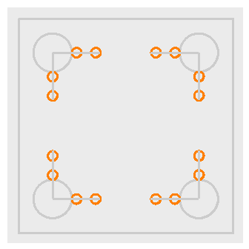
Litter and duff
Litter and duff depth measured from a representative location within the sampling cylinder
Depth-to-load equation taken from the literature

Slide 24
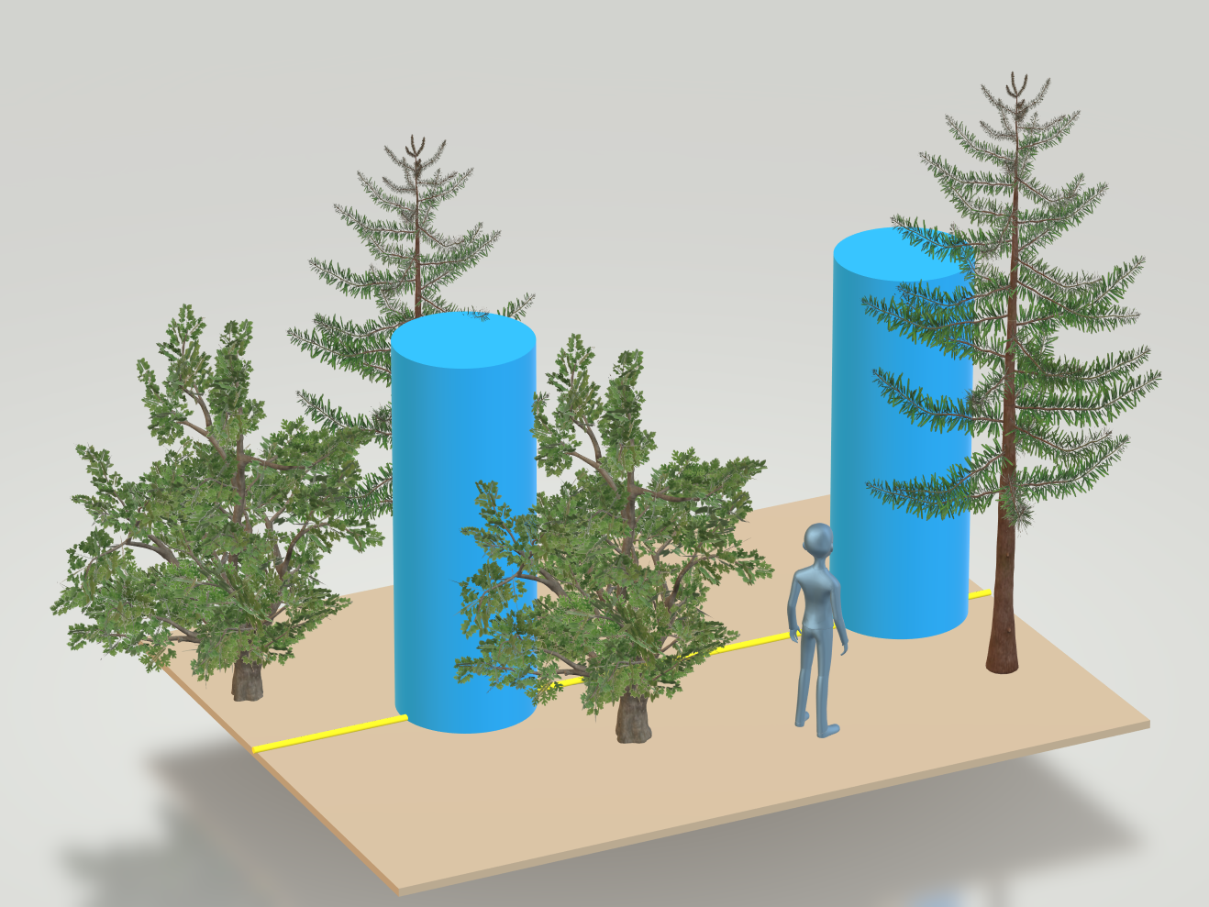
Vegetation
We estimated percent cover and average height
Converted to load using a constant bulk density

Slide 25
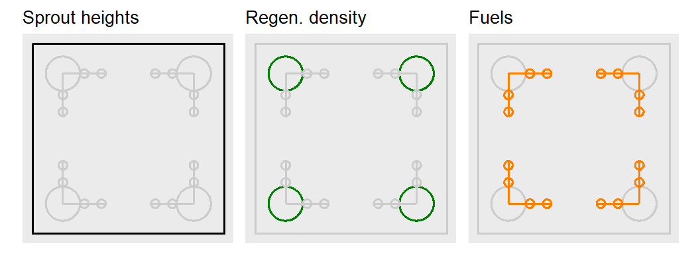
Sampling review
Notes:
That was a lot of response variables. Here they are summarized in three categories.

Slide 26
What we did
Implementation
Sampling procedure
Analysis
Notes:
By the end of this section, you’ll have an idea of they methods I used to anlyze these data.

Slide 27
Sprout height
Frequentist framework
Model selection was performed using AIC
Treatment and year were factors
Tested various random effects
Included fixed effect model for dispersion
Model checked using simulated residuals

Slide 28
Regeneration density
I report on:
Species diameter frequency distributions and
Basal area weighted frequency distributions
for each treatment.

Slide 29
Fuel
Bayesian framework
Separate models for six different fuel classes
Used $gamma$ hurdle model: zeros modeled separately as a proportion
Priors determined from data with support from literature
Model checked with posterior predictive distribution

Slide 30
Today’s plan
What we did
Why we did it
Some results
My questions
Your questions

Slide 31
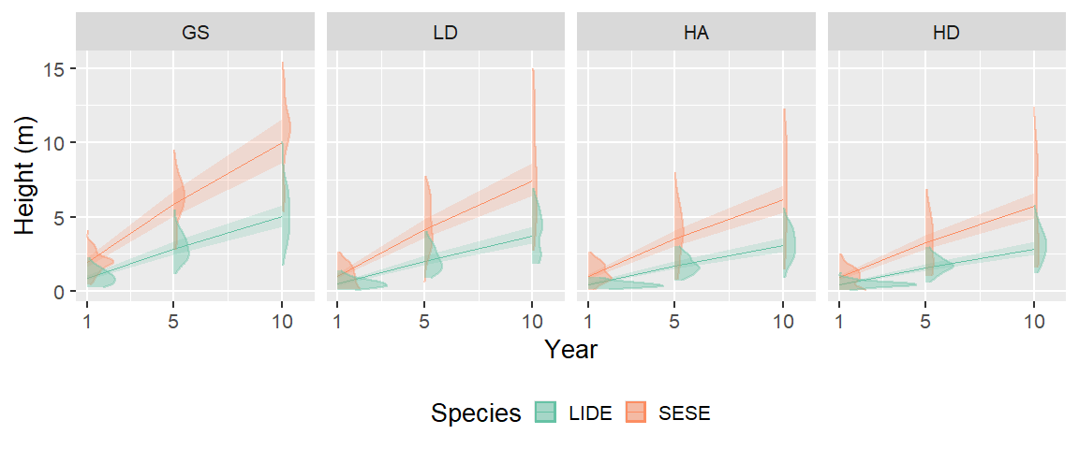
Sprout height model
Notes:
redwood is growing faster than tanoak
redwood is taller than tanoak
the difference in slow down in growth rates is negligible across treatments
redwood is more variable than tanoak
Is the slow down in growth rate different between species?
Is the slow down statistically significant?

Slide 32
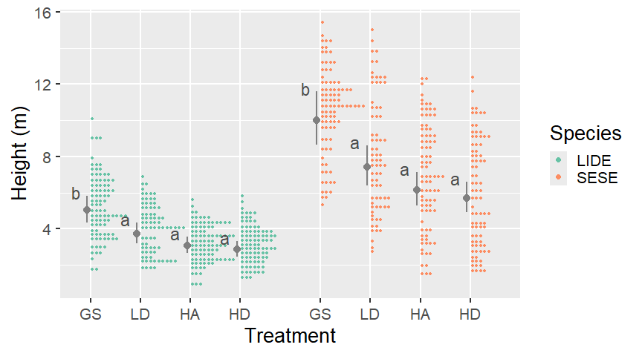
Sprout height: year 10
Notes:
Our data were only sufficient to detect a statistical difference for height in year 10 for the GS treatment

Slide 33
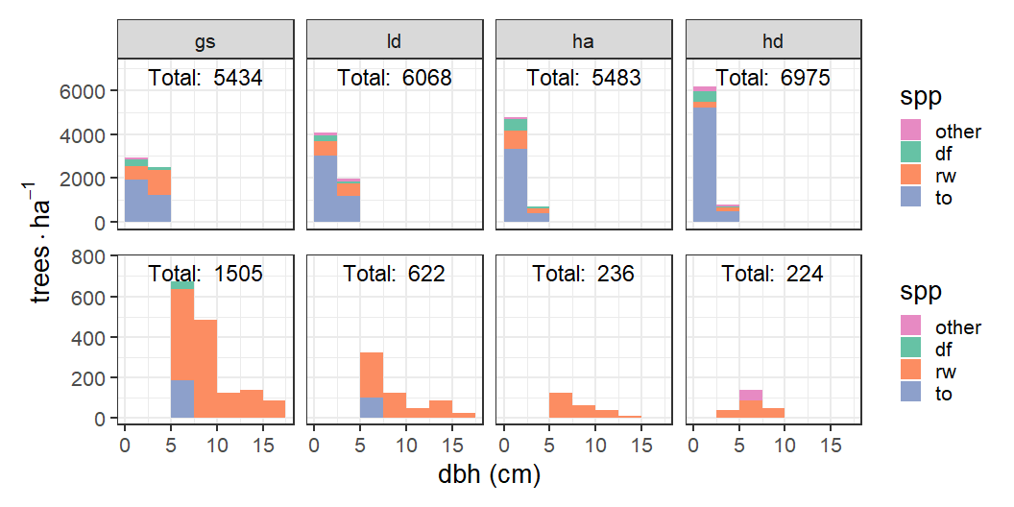
Regeneration density: frequency
Notes:
the number of tanoak in the smallest size class increases with greater competition.
the number of stems in other size classes follow a decreasing trend
The decreasing trend is more pronounced for redwood

Slide 34
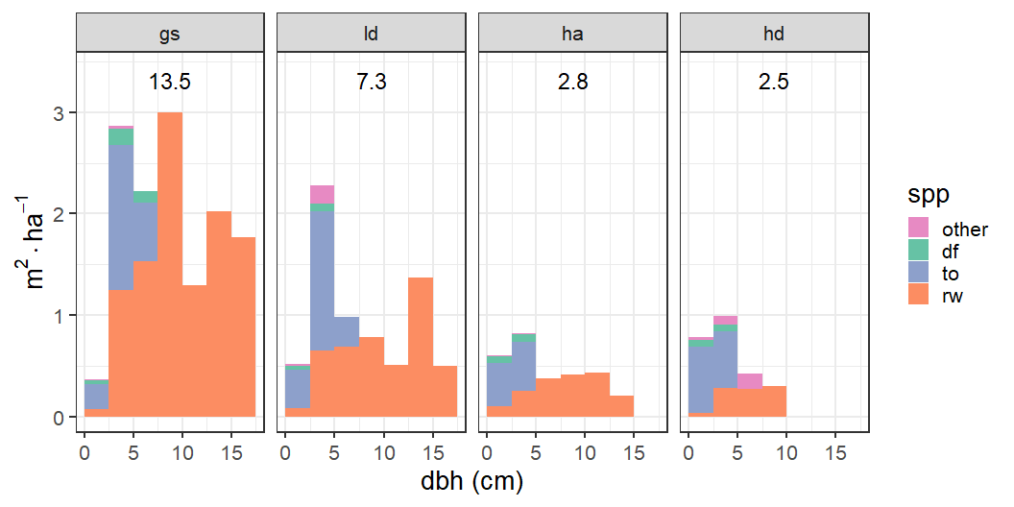
Regeneration density: basal area
Notes:
This emphasizes the decreasing trend in redwood abundance
The trend is less clear for tanoak

Slide 35
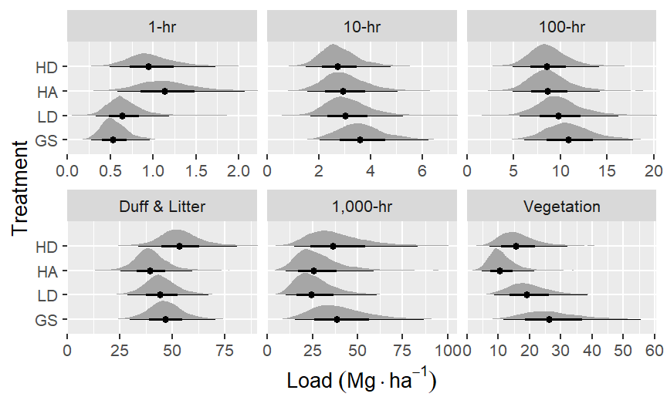
Fuel: means
Notes:
1hr fuels are slightly higher in HD and HA and lower in LD and GS. Likely due to inputs from residual trees.
10– and 100hr fuels are very similar across treatments, but slightly increasing with increasing light.
duff & litter are highest in HD and lowest in HA. Why?
veg is lowest in HA, highest in GS

Slide 36
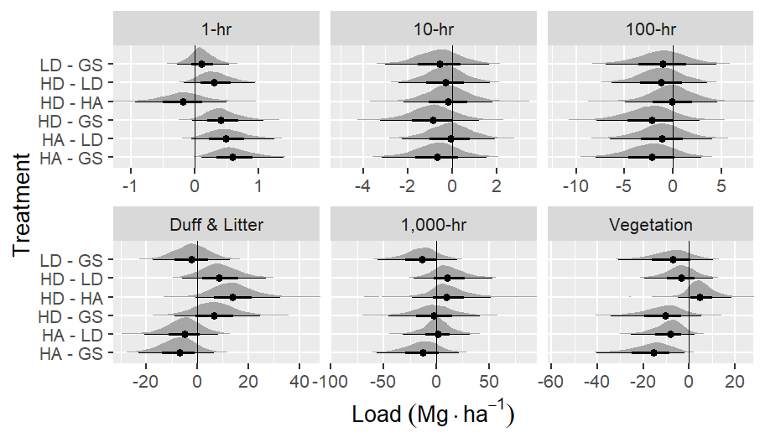
Fuel: comparisons
Notes:
1hr HA > GS, and almost HA > LD. Also HD almost > GS
Duff & Litter HD maybe greater than HA
veg GS > HA; LD maybe > HA

Slide 37
Today’s plan
What we did
Why we did it
Some results
My questions
Your questions

Slide 38
My questions
How to add post-pct to the story
Potential questions generated by regen. distributions
“Asking questions” of the height model: confidence intervals

Slide 39
Today’s plan
What we did
Why we did it
Some results
My questions
Your questions

Slide 40
Questions?
learn more at online at:
https://fisher-j.github.io/multi-age

Slide 41
Thanks again

Slide 42
Downed woody fuel classes
Class name | Size (cm) | Transect length (m)
1 hr | < 0.64 | 1
10 hr | 0.64 - 2.5 | 2
100 hr | 2.5 - 7.6 | 4
1,000 hr | > 7.6 | 10

Slide 43
Vegetation: Load calc.
We calculated average load for herbaceous and woody vegetation:
$$load=ht.×pct.cover×ρ,$$
where $ρ$ is a bulk density of 8 and 18 Mg/ha/m for herbaceous and shrub components, respectively.

Slide 44
Fuel bed depth
We estimated the combined average fuel bed depth of all litter and downed woody debris within the sampling cylinder.

Slide 45
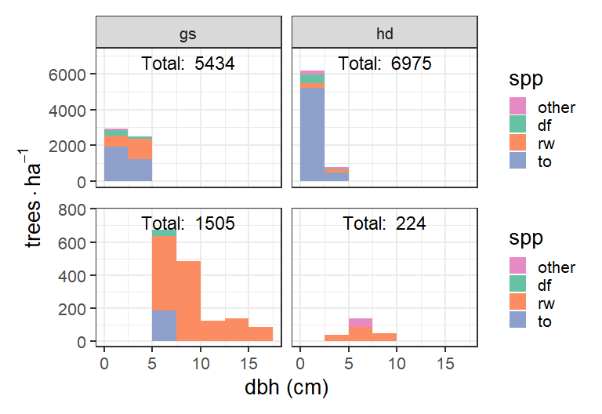
Regeneration density: frequency

Slide 46
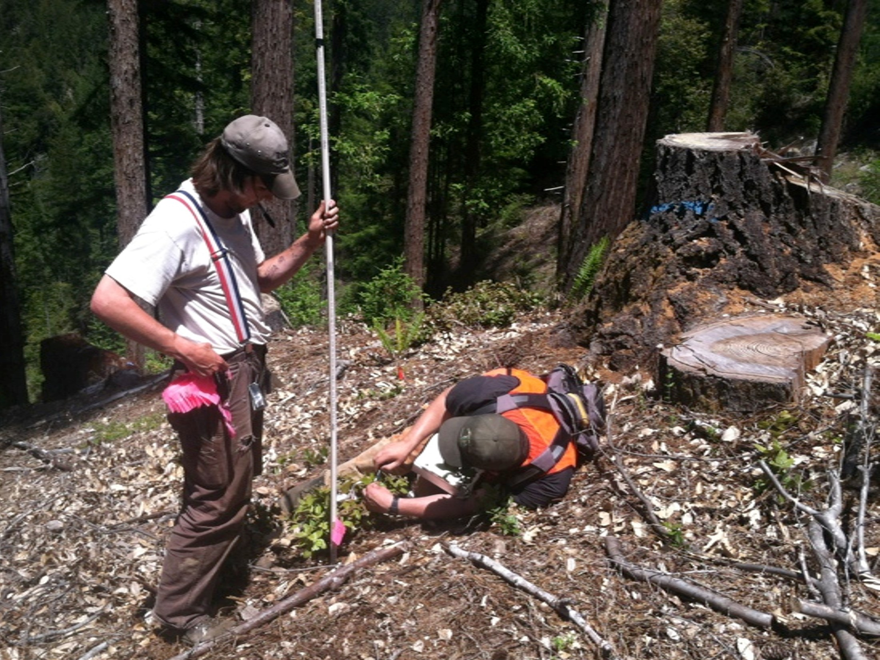
Year 1 height measurement

